Slide 1
MANUAL IMAGE REVIEW • PLATE REVIEW TRAINING
Vanity Plates
Identifying ambiguous characters on vanity and specialty plates
September 03, 2026
SWC Group Property

Slide 2
INTRODUCTION
O vs 0 and 0
Why This Distinction Matters
O
Why misreading O vs 0 causes errors
The core problem is that O and 0 are visually near-identical in a lot of plate fonts, especially in the state of Texas — same round shape, same stroke weight — so the eye has almost nothing to go on besides subtle width and shape cues for many plates.
How it affects downstream matching/billing
Registration data only has value if it matches the DMV/registration database exactly — toll billing is a character-for-character lookup. If a plate gets submitted incorrectly , the system will either:
Fail to find a match at all, kicking the transaction into a reconciliation/exception queue and delaying/prevent billing, or
Much worse, matches to a different real, valid plate combination, which means the wrong vehicle owner gets billed and the actual toll-taker doesn’t.
Another major issue is with Texas Vanity plates with a letter O or number 0 in it. If this plate gets entered incorrect and the O and 0 are swapped, the Toll-Tag will not be charged but the DMV will still bill them, which causes major escalations and complaints.
Any of one these outcomes create downstream cleanup work — reconciliation, disputes, chargebacks — that's disproportionate to what looks like a one-character slip at review time.
Letter
Never appears in standard-issue plate numbers on states like Texas — but can appear on vanity plates in any states
0 or 0
Digit
Standard on registration numbers across every state we review
Vanity Plates Training
2

Slide 3
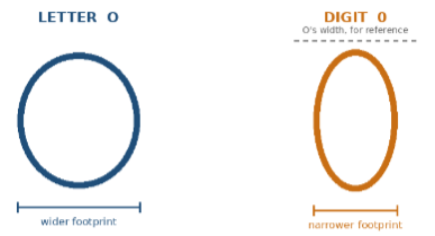
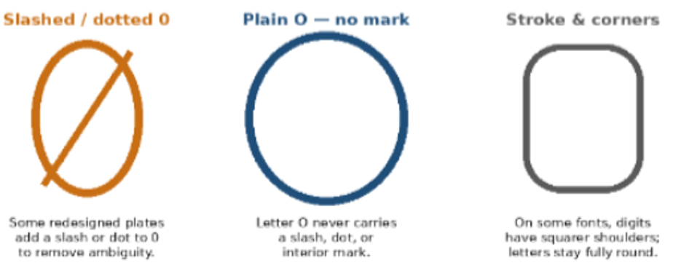
THE FUNDAMENTALS
Shape Is Your First Clue
Keep in mind:
Each state has their own way of differentiating between the letter and the number. It is important we pause and pay attention anytime either one of these characters appear.
Vanity Plates Training
3

Slide 4
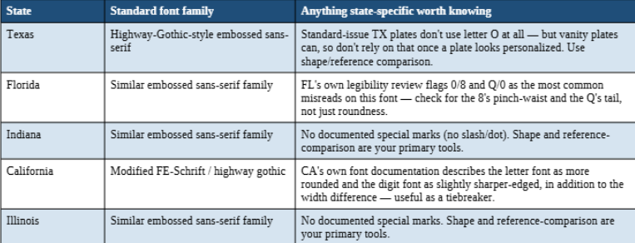
REFERENCE
Common State Font Clues
Vanity Plates Training
5

Slide 5
THE FUNDAMENTALS
Texas Vanity Plates: When Shape Alone Isn't Enough
Texas Vanity plates can have the letter O and the number 0 in them. We must use context clues to help Identify which to enter considering Texas Vanity plates can be more challenging to determine the character than other states. Not all these clues will apply in every scenario so be practical and consider the most likely entry.
If it’s a custom/vanity plate, best rule of thumb is to lean towards it being a Letter O, especially if there are no numbers in the registration.
Use context clues to determine if the letter O or the number 0 should be used. Example: Registration is ‘JACK01’. Since the 0 character is next to a 1, it would be best judgment to use the number Zero.
Plates that you can read as a word like ‘TEX-M4DE’ is a custom plate. The driver wanted the plate to read as “Texas Made”, which indicates this being a custom plate.
The state of Texas usually issues plates with 6-7 characters. The USUAL standard layout follows a format of two letters, one number, one letter, and three numbers (e.g., AB1-C123). If the plate in question is outside these criteria’s, then this COULD indicate it is a special kind of plate, including vanity plates that can use O’s and 0’s.
Keep in mind: Even though the State Of Texas does not issue plates with the letter O in the registration, drivers can still obtain custom plates with the letter O in them.
Vanity Plates Training
4

Slide 6
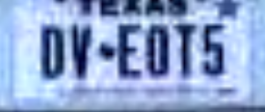
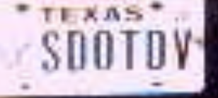
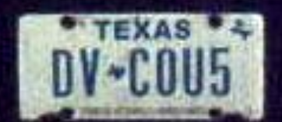
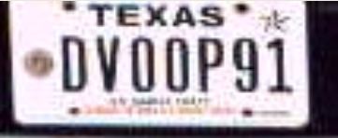
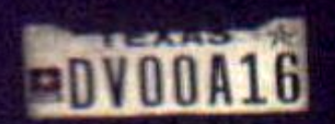
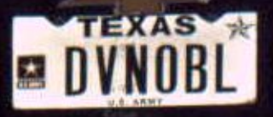
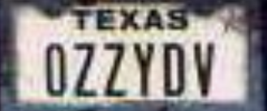
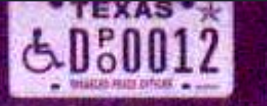

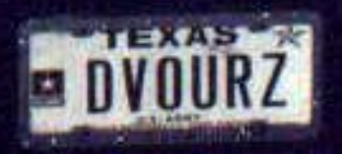
THE FUNDAMENTALS
Texas DV Vanity Plates
Keep in mind: Even though the State Of Texas does not issue plates with the letter O in the registration, drivers can still obtain custom plates with the letter O in them.
Vanity Plates Training
4

Slide 7
PRACTICE SET
Texas Vanity Plates
For every example, identify the ambiguous character(s) and decide: Letter O or Digit 0?
Vanity Plates Training
6

Slide 8
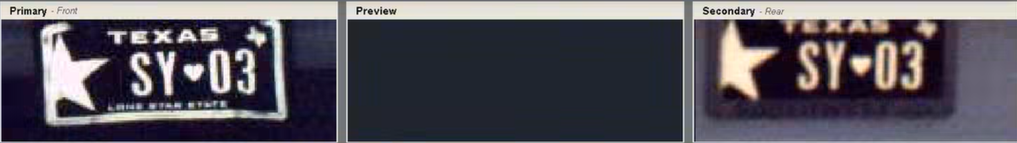
TEXAS PLATE 1
Identify the Character(s)
State / Plate Type:
TEXAS
Character(s) in Question:
SY?3
Verdict — Letter O or Digit 0:
This is the NUMBER 0: SY03
Reasoning / Teaching Point:
Since the 0 character is next to another number, it would be best judgment to use the number Zero.
Texas Plate 1 of 8
Vanity Plates Training
7

Slide 9
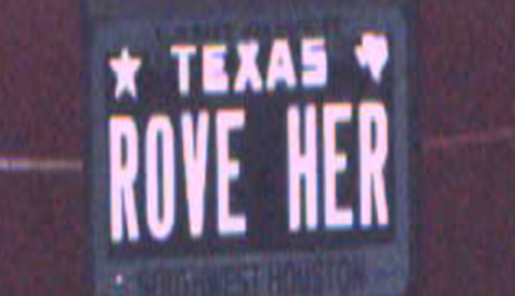
TEXAS PLATE 2
Identify the Character(s)
State / Plate Type:
TEXAS
Character(s) in Question:
R?VEHER
Verdict — Letter O or Digit 0:
This is the LETTER O: ROVEHER
Reasoning / Teaching Point:
This is an obvious custom plate by seeing its all letters spells out words.
Texas Plate 2 of 8
Vanity Plates Training
10

Slide 10
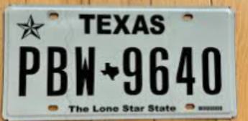
TEXAS PLATE 3
Identify the Character(s)
State / Plate Type:
TEXAS
Character(s) in Question:
PBW964?
Verdict — Letter O or Digit 0:
This is the NUMBER 0: PBW9640
Reasoning / Teaching Point:
This is a recognizable state issued plate and meets standard state issued plate criteria.
Texas Plate 3 of 8
Vanity Plates Training
12

Slide 11
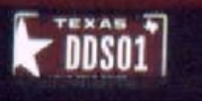
TEXAS PLATE 4
Identify the Character(s)
State / Plate Type:
TEXAS
Character(s) in Question:
DDS?1
Verdict — Letter O or Digit 0:
This is the NUMBER 0: DDS01
Reasoning / Teaching Point:
Since the 0 character is next to another number, it would be best judgment to use the number Zero.
Texas Plate 4 of 8
Vanity Plates Training
9

Slide 12
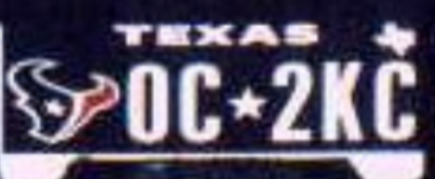
TEXAS PLATE 5
Identify the Character(s)
State / Plate Type:
TEXAS
Character(s) in Question:
?C2KC
Verdict — Letter O or Digit 0:
This is the LETTER O: OC2KC
Reasoning / Teaching Point:
There are no numbers around the O in question, and the Registration does not meet the Standard Issue Plate Criteria. (Using best judgement with context clues Is key!)
Texas Plate 5 of 8
Vanity Plates Training
11

Slide 13
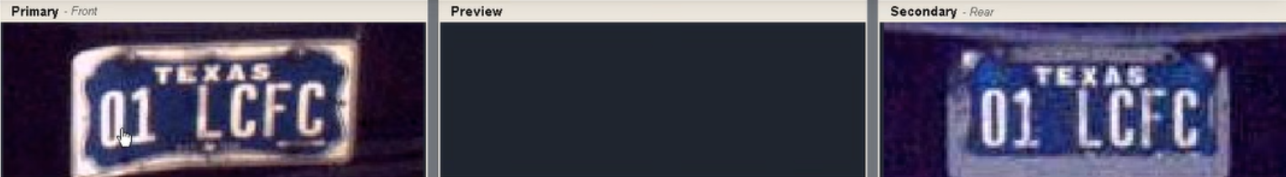
TEXAS PLATE 6
Identify the Character(s)
State / Plate Type:
TEXAS
Character(s) in Question:
?1LCFC
Verdict — Letter O or Digit 0:
This is the NUMBER 0: 01LCFC
Reasoning / Teaching Point:
Since the 0 character is next to another number, it would be best judgment to use the number Zero.
Texas Plate 6 of 8
Vanity Plates Training
8

Slide 14
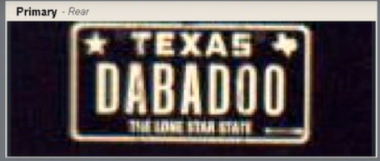
TEXAS PLATE 7
Identify the Character(s)
State / Plate Type:
TEXAS
Character(s) in Question:
DABAD??
Verdict — Letter O or Digit 0:
This is the LETTER O: DABADOO
Reasoning / Teaching Point:
This plate is spelling out a word, all other characters are letters, no numbers around the character in question, Not meeting Stand Issue Plate Criteria, Custom Plate.
Texas Plate 7 of 8
Vanity Plates Training
14

Slide 15
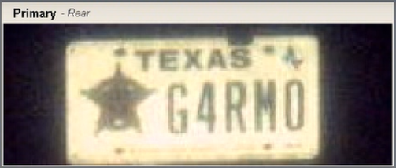
TEXAS PLATE 8
Identify the Character(s)
State / Plate Type:
TEXAS
Character(s) in Question:
G4RM?
Verdict — Letter O or Digit 0:
This is the LETTER O: G4RMO
Reasoning / Teaching Point:
There are no numbers around the O in question, the plate is attempting to appear as a word, and the Registration does not meet the Standard Issue Plate Criteria.
Texas Plate 8 of 8
Vanity Plates Training
13

Slide 16

TEXAS PLATE 9
Identify the Character(s)
Some plates are hard to tell. Use your best judgment with all the context clues and knowledge you have obtained to determine what’s the best course of action.
Vanity Plates Training
15

Slide 17
PRACTICE SET
Other State Vanity Plates
For every example, identify the ambiguous character(s) and decide: Letter O or Digit 0?
Vanity Plates Training
16

Slide 18
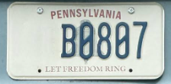

PRACTICE PLATE 1
Identify the Character(s)
State / Plate Type:
PENNSYLVANIA
Character(s) in Question:
B?8?7
Verdict — Letter O or Digit 0:
These are both the NUMBER 0: B0807
Reasoning / Teaching Point:
The state of Pennsylvania uses the unique zero with the slash to easily identify the digit. (We must ensure we are not mixing up 8’s with Zeros for these type of situations)
Plate 1 of 2
Vanity Plates Training
20

Slide 19
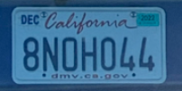

PRACTICE PLATE 2
Identify the Character(s)
State / Plate Type:
CALIFORNIA
Character(s) in Question:
8N?H?44
Verdict — Letter O or Digit 0:
This plate has BOTH, the LETTER O and the NUMBER 0: 8NOH044
Reasoning / Teaching Point:
California uses the more squared character for letter O’s and slimmer more round character for number 0.
Plate 2 of 2
Vanity Plates Training
19

Slide 20
DATA ENTRY ACCURACY
Entering Plate Information Correctly
These are real examples where the plate information was entered differently by different reviewers that were processed incorrectly and resulted in charge issues that requires the customer to dispute and complain to correct. Compare each entry against the image and decide which is correct.
Vanity Plates Training
21

Slide 21
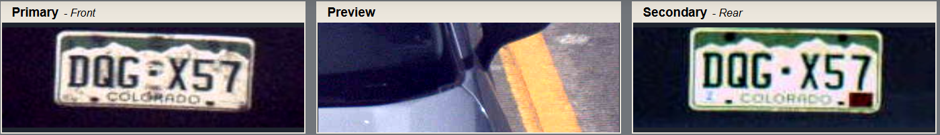



ENTRY EXAMPLE 1
Which Entry Is Correct?
Submitted entries:
Correct entry & why the others are wrong:
1 rep selected Q correctly and 2 reps selected G instead of Q and C instead of G.
This resulted in billing the wrong person.
How to improve:
Slow down and ensure the correct information is being entered.
Be aware of Q’s, C’s, 6’s and G’s as these can be mixed up easily.
Vanity Plates Training
22

Slide 22
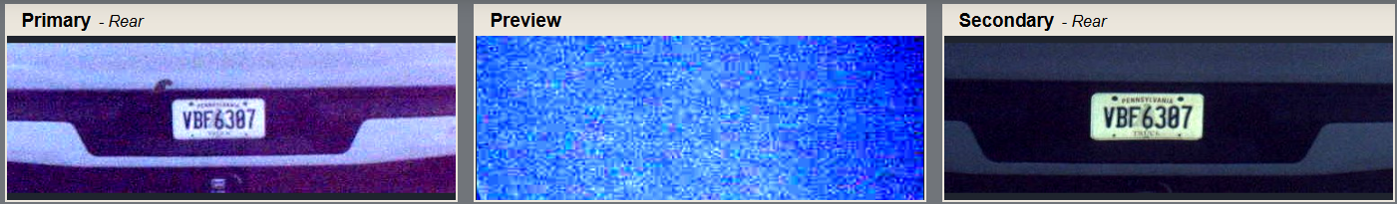




ENTRY EXAMPLE 2
Which Entry Is Correct?
Submitted entries:
Correct entry & why the others are wrong:
This plate is using the special character for a zero with a slash. 2 reps selected an 8 instead of a 0, and 1 agent selected a 0.
This resulted in billing the wrong person.
How to improve:
Slow down and ensure the correct information is being entered.
Be aware of O’s, Zero’s, and 8’s as these can be mixed up easily.
Plate find can zoom in further on plates in help visibility.
Vanity Plates Training
23

Slide 23
KEY TAKEAWAYS
Things to remember
Most common entry errors:
Letter O’s, Number 0’s, and Number 8’s can be mixed up easily.
Texas plates: Parallel 6-vs-G swaps.
Vanity Texas Plates: O’s and Zero’s are hard to determine between. Use context clues to help determine the best choice.
W & M swapped.
X & Z swapped.
B & 8 swapped.
L & 1 swapped.
Q’s, C’s, 6’s and G’s swapped.
Adding extra or missing alphanumeric characters in the registration field.
Texas: Number 6 & Letter G confusion.
Plates with the combination "WMR" or "XKW" flagged specifically as needing extra care on entry accuracy (these letter combos trigger the same W/M and X/Z confusion patterns above).
Vanity Plates Training
24

